Slide 1
FDP
From Pipelines to Production
Dr. Shreyas Rao
Professor, Dept. of CSIS, BITS-Pilani

Slide 2
Day 3
The Generative System: RAG, LLMOps and AgentOps

Slide 3
Fundamentals of Agentic AI
[Credit: Prof. Chetana, Prof. CSIS]

Slide 4
Agentic AI
Definition 1 [Nvidia]
"Agentic AI uses sophisticated reasoning and iterative planning to autonomously solve complex, multi-step problems.“
Definition 2 [OpenAI]
"Agentic AI systems are AI systems that can pursue complex goals with limited direct supervision"
Definition 3
“A system based on a foundation model that performs tasks potentially yielding artifacts based on natural user instructions, where the system is able to conduct and express complex reasoning including planning and reflection to solve tasks that require interaction with an environment or elaborate tool use”

Slide 5
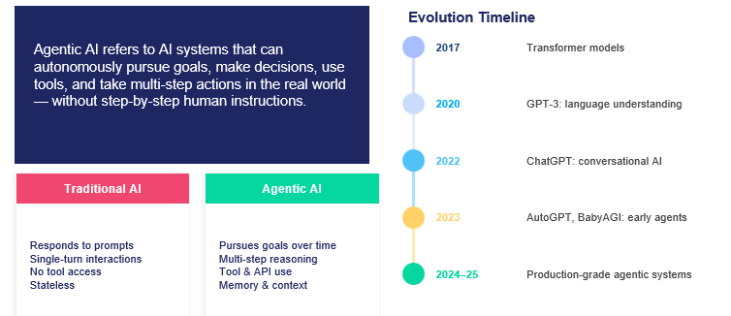
From Chatbots to Doers:
What is Agentic AI?

Slide 6
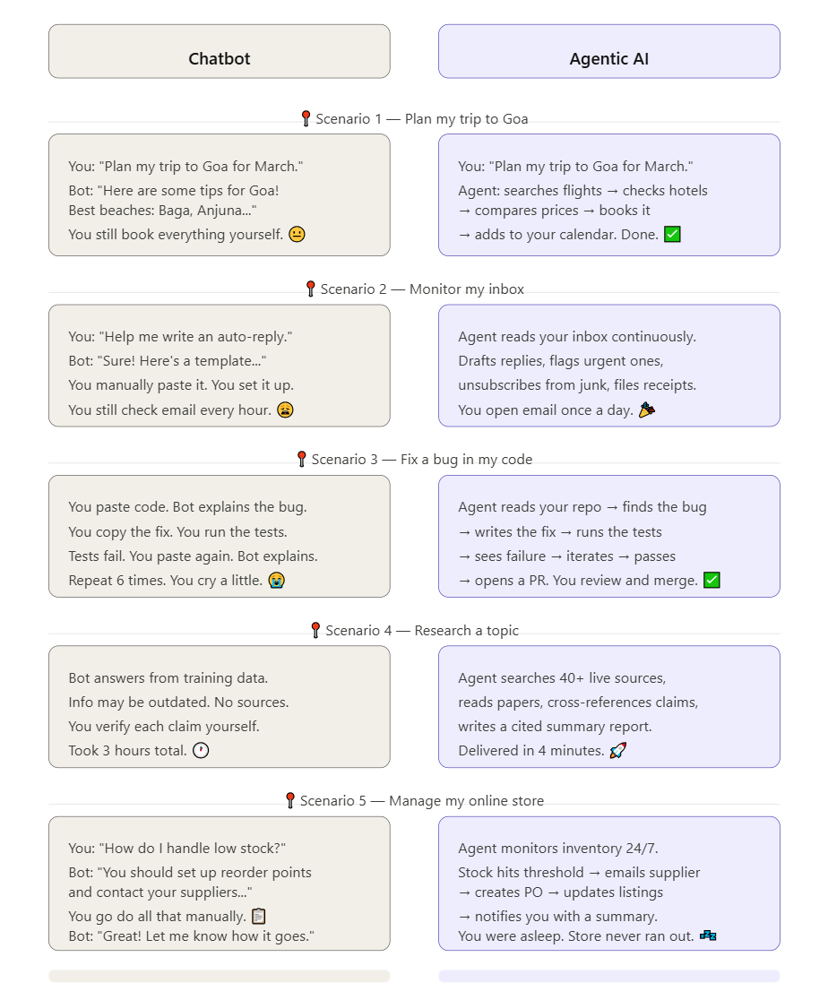
Chatbots vs Agentic AI

Slide 7
Chatbots vs Agentic AI

Slide 8
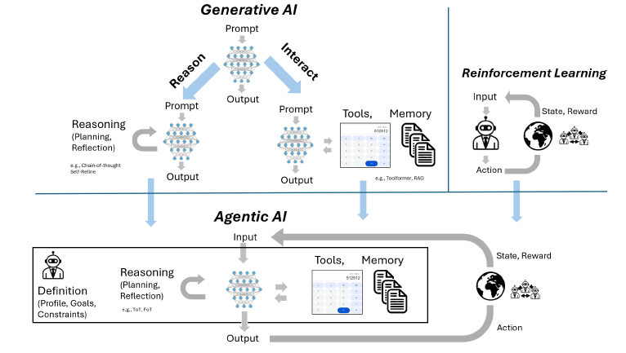
Generative vs Agentic AI
Tools: Calculators, APIs, Databases etc.
Memory: Past Context, RAGs, Documents
Generative AI: "Tell me what to do, I’ll generate an answer"
Agentic AI: "Give me a goal, I’ll figure out the steps, act, and improve until it’s done"
Generative AI + Reasoning + Tools + Feedback Loops → Agentic AI

Slide 9
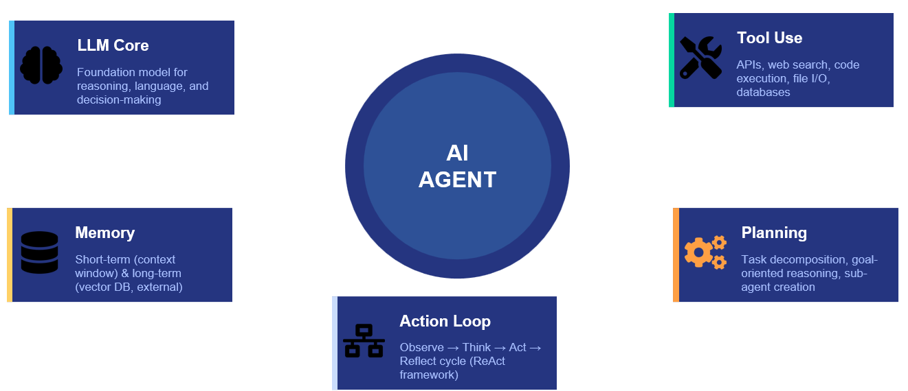
Components of Agentic AI

Slide 10
LLM as Reasoning Engine
Why LLMs Power Modern Agents
Chain-of-thought reasoning
Breaks a problem into step-by-step thinking before acting
Think step-by-step before acting
Instruction following
Converts human language instructions into executable actions
Translate natural language goals to actions
Generalization
Applies learned knowledge to new, unseen tasks without retraining
Handle novel tasks without retraining
Tool use via JSON/API
Formats outputs so external tools and APIs can be called automatically
Structure outputs to call external tools
Self-correction
Reviews and improves its own responses to reduce errors
Evaluate own outputs and revise

Slide 11
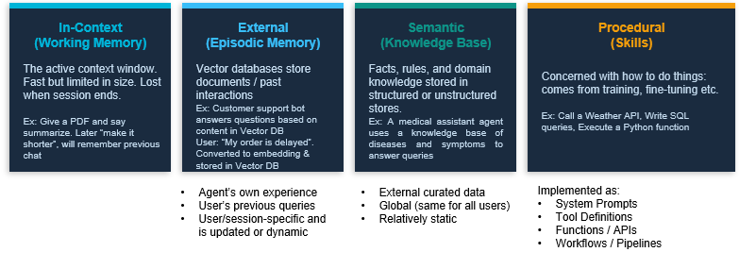
Memory/State in Agentic Systems

Slide 12
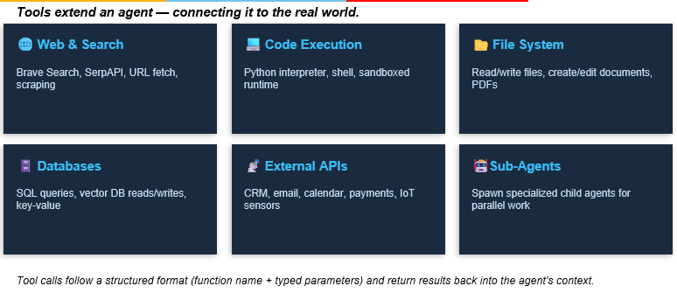
Tool use and Action Execution

Slide 13
Tools in Agentic AI
In agentic AI, “tools” are external capabilities that an AI agent can invoke to take actions, retrieve information, or interact with other systems, rather than only
{
"tool_name": "function_name"
"arguments": {
"param1": "value1",
"param2": "value2"
}
}
Sample Function Call
{
"name": "get_weather",
"arguments": {
"city": "Bangalore"
}
}
Sample Result
{
"tool_result": "Temperature is 28°C"
}

Slide 14
Tool Types
Tool type | What the agent can do | Examples
Web/Search tools | Find current information | Web search, news search, browsing
API tools | Interact with external services | REST APIs, weather API, payment API
Database tools | Query or update data | SQL, PostgreSQL, MongoDB, vector databases
Code execution | Run calculations/programs | Python, JavaScript, shell
File tools | Read/write documents | PDFs, CSVs, Excel, JSON
Communication tools | Send/read communications | Email, Slack, Teams
Business-system tools | Perform organizational actions | CRM, ERP, ticketing systems
Retrieval/RAG tools | Search private knowledge | Vector search, document retrieval
Computer-use tools | Operate software interfaces | Browser control, clicking, typing
Memory tools | Store/retrieve information across tasks | User preferences, task state
Specialized AI tools | Delegate particular tasks | Vision, speech, image generation, other agents

Slide 15
Agentic AI Demo 1: OpenAI AgentBuilder
Use “Web Search” tool to find current information

Slide 16
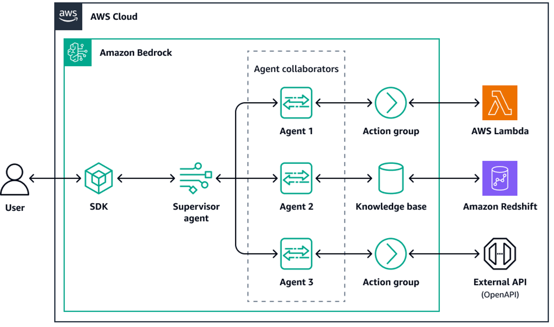
SAGA Orchestration
https://docs.aws.amazon.com/prescriptive-guidance/latest/agentic-ai-patterns/saga-orchestration-patterns.html

Slide 17
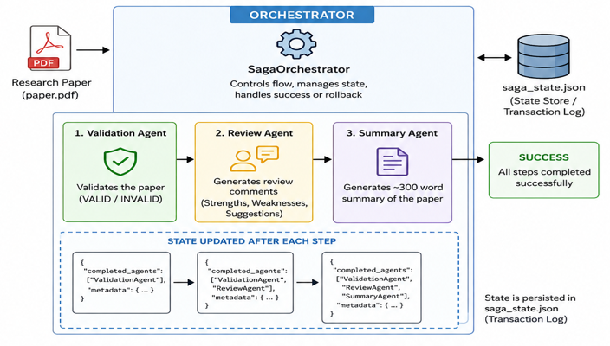
Agentic AI Demo 2
Multi-Agent Research Paper Processing
Validation Agent -> State Valid / Invalid
Review Agent -> Provide Strengths /Weaknesses / Suggestions
Summary Agent -> 300-word summary of the paper
agentic-ai-app

Slide 18
AgentOps

Slide 19
AgentOps Tools
AgentOps Area | Tool | Purpose
Agent Framework / Runtime | OpenAI Agents SDK | Build and execute the Validation, Review and Summary agents
Agent Orchestration | OpenAI Agents SDK | Control agent sequence, handoffs and workflow
LLM Model | OpenAI API | Power the individual agents
Document Processing | PyPDF / PyMuPDF | Extract research-paper content
Observability / Tracing | Langfuse | Trace agents, LLM calls, handoffs, inputs/outputs, latency, tokens and errors
Agent Evaluation | RAGAS / custom evaluators | Evaluate quality of generated outputs and, where applicable, retrieved context
Guardrails | OpenAI Agents SDK Guardrails | Validate inputs/outputs and constrain agent behavior
Experiment Tracking | Langfuse | Compare agent versions, prompts, models and runs
Prompt Management | Langfuse | Version and manage agent instructions/prompts
Application / Demo UI | Streamlit | Upload paper and display results from the three agents
Configuration / Secrets | .env | Manage OpenAI and Langfuse credentials
Development | VS Code | Development and experimentation

Slide 20
Evaluation Results
validation_valid
validation_confidence
review_completeness
summary_length_score
summary_faithfulness
summary_score
review_faithfulness
agentic-aiops

